Slide 1

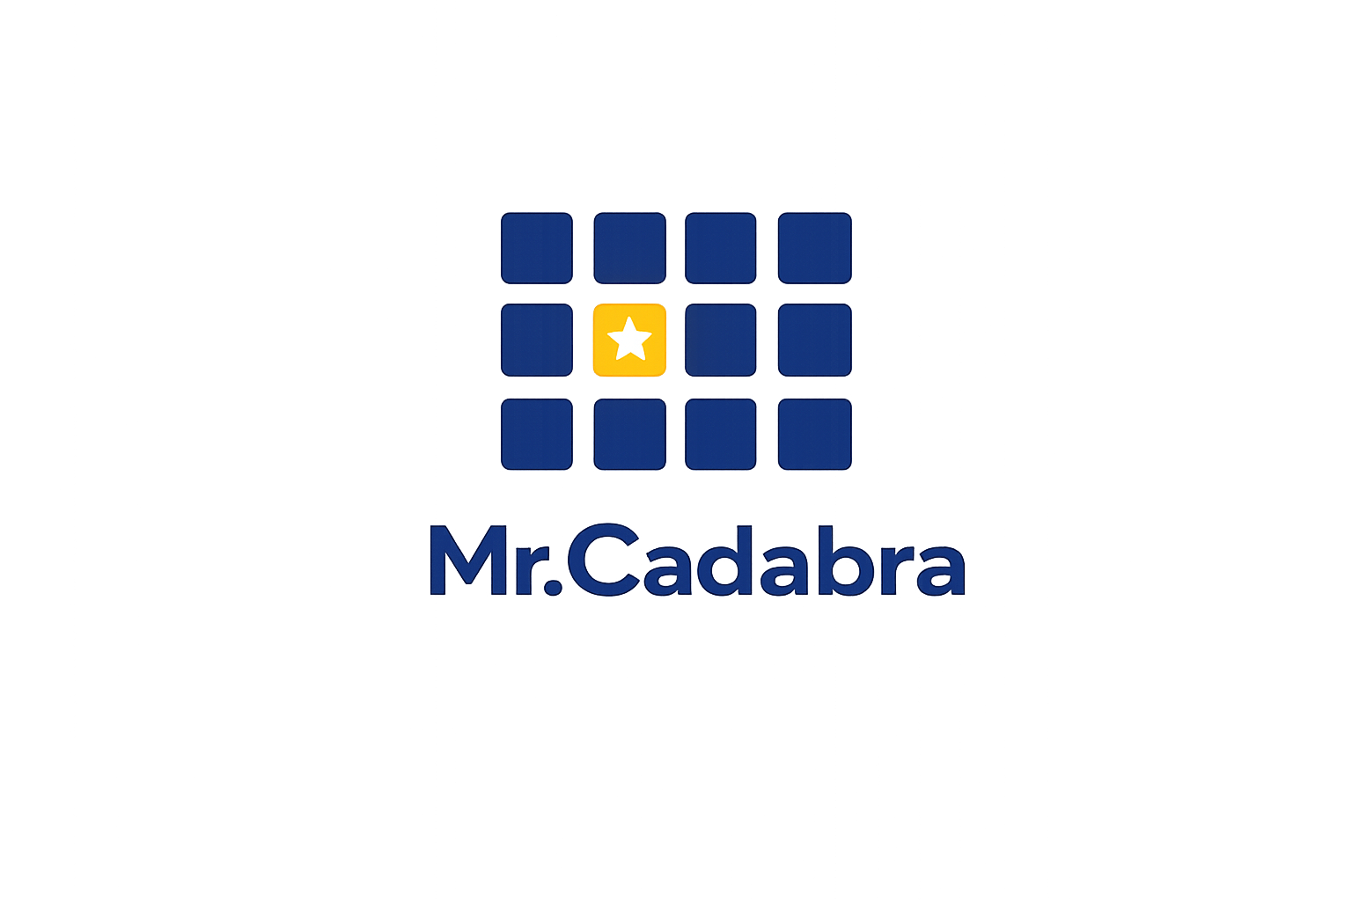
• FOR HOMESCHOOL FAMILIES •
— AI-Powered Tutor —
Your child's personal math tutor
Patient, adaptive math tutoring with automatic homeschool records.
mrcadabra.com
Notes:
Homeschooling math is a big job. Mister Cadabra is a patient, personal math tutor for every homeschool student. And while it teaches, it automatically keeps the homeschool records you'll need.
**Slide 1 — See your whole class at a glance.** If you teach math to more than one student — a co-op, a microschool, or a classroom — here's what Mr.Cadabra looks like from the front of the room. **Slide 2 — Every student, tutored one-on-one.** Every student in your class gets the same patient one-on-one tutor, working at their own placed level. That means intervention without stigma — a ninth grader can quietly rebuild fractions without ever seeing a grade level on screen. **Slide 3 — The mastery heatmap.** This is your classroom view: the mastery heatmap. Every cell is a student's best real check score on a unit — gold stars mean mastered. And "needs attention" names the unit your whole class is weakest on, so you know exactly what to reteach. **Slide 4 — Drill into any student.** Click any name and you get that student's full dashboard — their units, their accuracy, their streak, and honest time-on-task where idle minutes never count. It's the picture you'd build by hand, already built. **Slide 5 — Built for real classrooms.** It's built for the realities of a classroom. You add students by code — no student emails, no new personal data. There are no microphones to manage; headphones are all you need. And the built-in course assessment maps each student's strengths for you. **Slide 6 — Pilot it free this term.** We're partnering with a limited number of classrooms this term: you get Mr.Cadabra free for the pilot, we get your honest feedback. Email support@mrcadabra.com and tell us about your class.

Slide 2
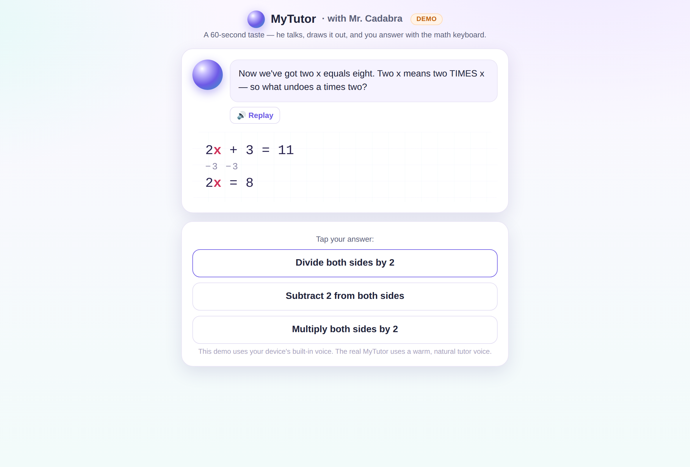

He teaches out loud, step by step
Mr.Cadabra talks your student through every problem, draws it on the whiteboard, and never races ahead.
Ten complete courses, from Introductory Math through Calculus.
Notes:
Mister Cadabra teaches every lesson out loud, one step at a time, across ten complete courses — from Introductory Math through Calculus.

Slide 3
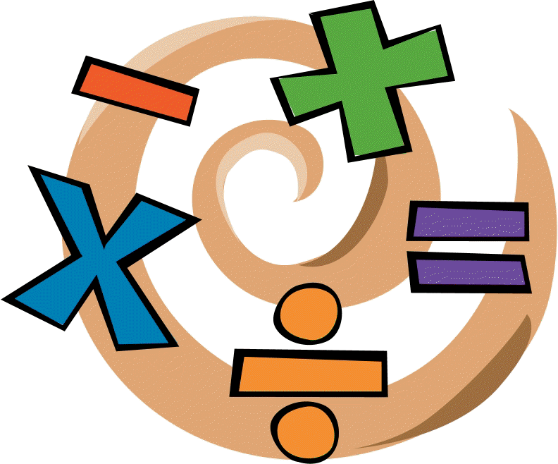

Assessment
A placement test finds where your student starts.
Periodic exams verify when they're ready to move on.
This Photo by Unknown Author is licensed under CC BY-ND
Notes:
A placement test finds where your student starts, and periodic exams verify when they're ready to move on.

Slide 4
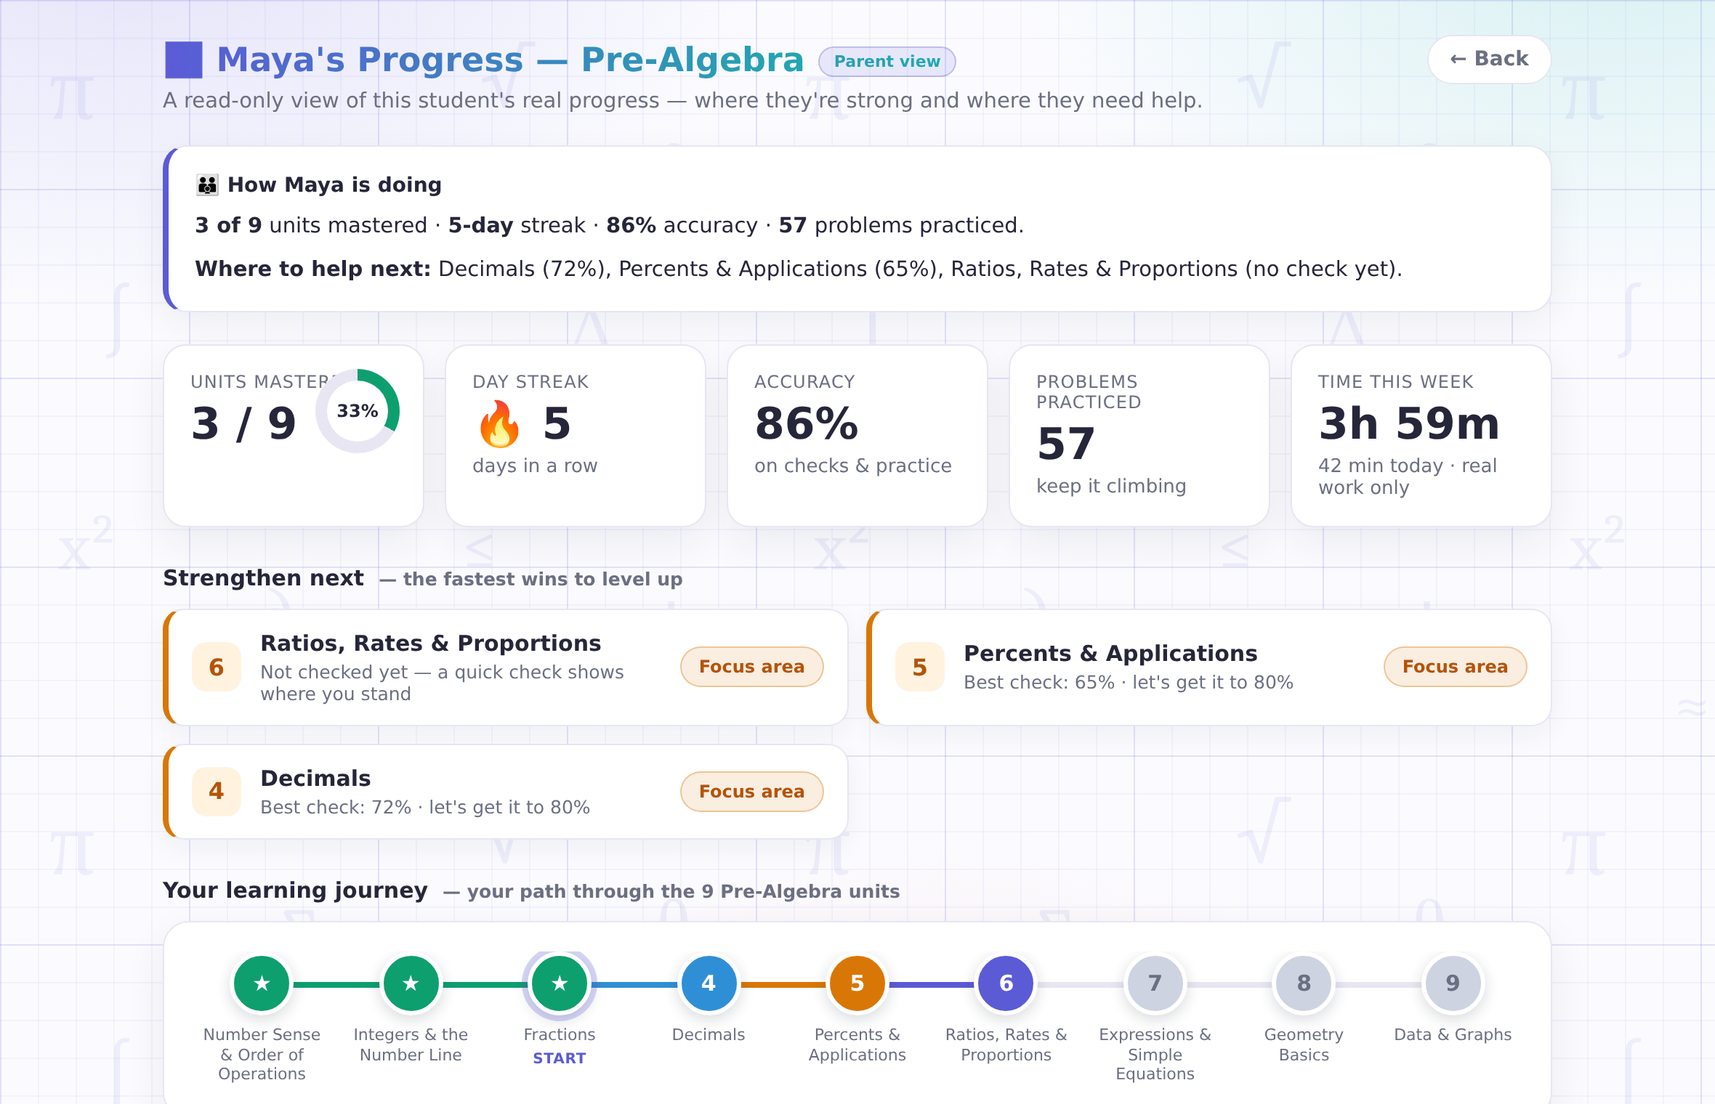

Watch the progress without hovering
Your read-only parent view shows what's mastered, what needs work, and exactly where to help next — updated after every lesson.
Notes:
After every lesson, your read-only parent view shows what's mastered, what needs work, and where to help next.

Slide 5
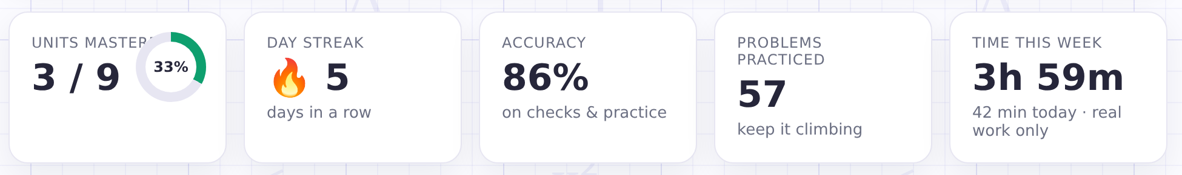
When logging hours is effortless
Instructional hours logs are kept automatically by Mr.Cadabra.
A minute counts only when your student is actually working.
Notes:
Many homeschool families need to log instructional hours. Mr. Cadabra keeps that record automatically, counting only the time your child is actively learning.

Slide 6



Homeschool records—done.
★
An hours log
A printable plan
Mastery evidence
Honest instructional minutes per day and per course, kept for you automatically.
Every course page doubles as a scope & sequence — print it for portfolios and filings.
Scored checks and assessment results — demonstrated skill, not just attendance.
Notes:
Mister Cadabra keeps your instructional hours, creates printable course plans, and documents your child's progress with real assessment results. You stay in control—we'll keep the records organized.

Slide 7
Ready to meet Mr.Cadabra?
— AI-Powered Tutor —
Try your first lesson free—no credit card or microphone required.
mrcadabra.com/homeschool
Become one of our first homeschool families to receive introductory pricing
and help shape what’s next.
Notes:
Ready to meet Mister Cadabra? Try your first lesson free—no credit card or microphone is required. Become one of our first homeschool families to receive introductory pricing and help shape what's next. Visit MisterCadabra.com slash homeschool to get started.

